Slide 1
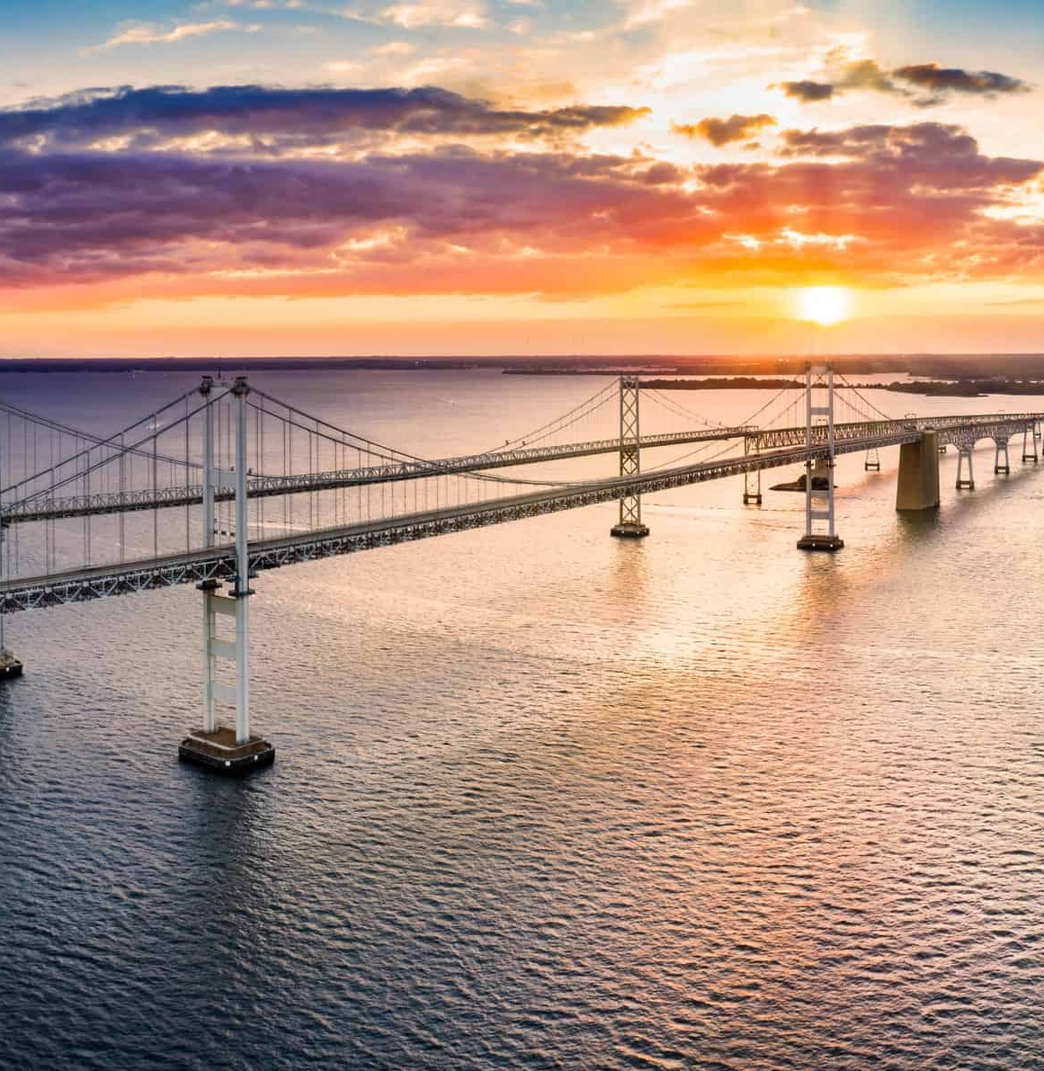

Bay Bridge Summer Travel Campaign 2026

Slide 2



Campaign Objectives
1
Visit baybridge.com
Drive audience to baybridge.com to learn more about the best times to travel
2
Safety Messaging
Encourage safe driving habits on the Bay Bridge. No tailgating, no speeding, no traveling in the red X lane.

Slide 3
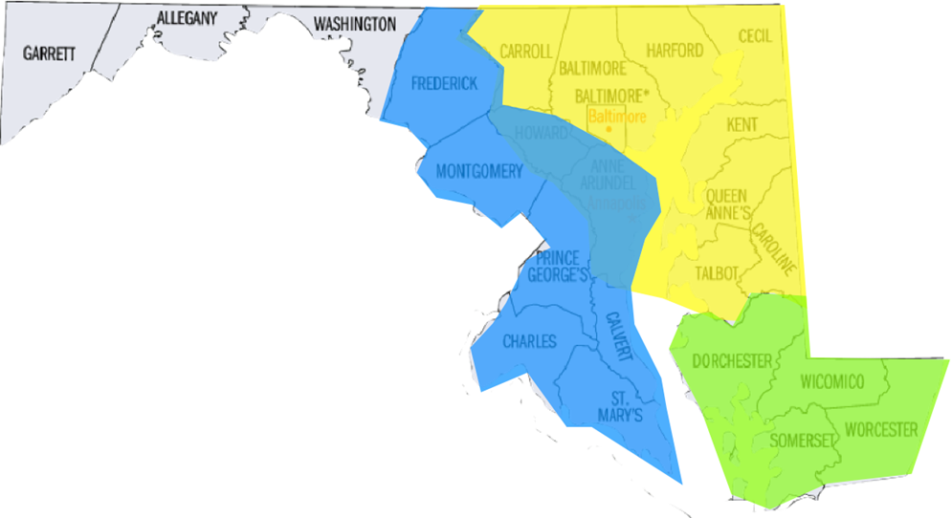
Campaign Overview
Dates
May 2026 – September 2026
Audience
Adults, 18+
Geography
Baltimore, Washington D.C., Annapolis, Eastern Shore, Salisbury/Ocean City, Delaware Beaches

Slide 4
Tactics
Billboards
Digital ads, including geo targeting and retargeting
Public outreach and grassroots - Ocean City
Restaurant coasters & window stickies – Ocean City
English and Spanish radio
Bus wraps – Ocean City & Baltimore
Ocean City seaboard
New Tactics – 2026
Grassroots - Kent Island
Ocean City aerial banner

Slide 5




Creative

Slide 6
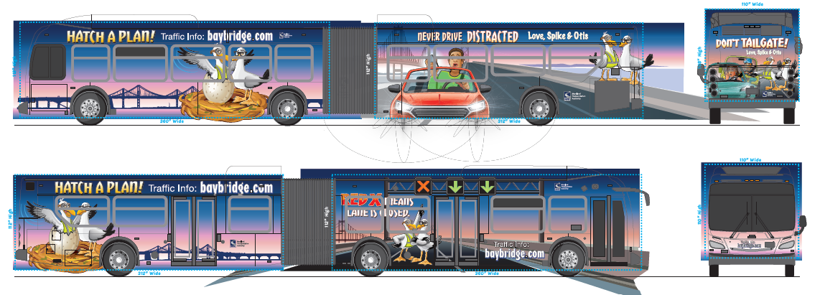
Bus Wrap
(These are renderings with guidelines for the printer. Those lines will not be present in the actual wrap)

Slide 7

Audio
Hatch a Plan
Red X
Safety Love Letter

Slide 8
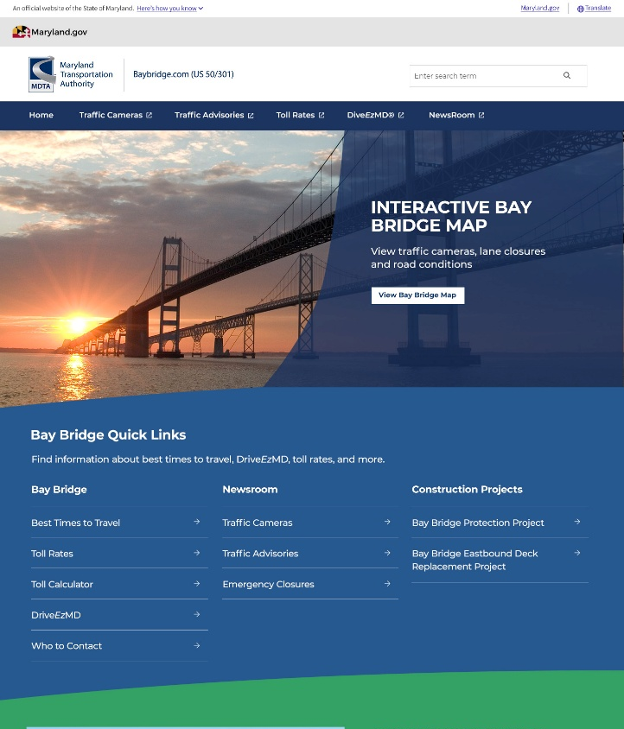
BayBridge.com Redesign

